Slide 1
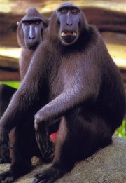
Unit 3 and 4 HUMAN BIOLOGY
CHAPTER 1 – EVOLUTION OF THE PRIMATES

Slide 2
Evolution of the Primates
Carolus Linnaeus (1707-78) established the basis of our present system of classification and the binomial system for naming organisms using the generic (genus) and specific (species) names to describe a species. In his system, which is still in use today, humans are classified into the genus Homo and the species sapiens, hence our scientific name, Homo sapiens.

Slide 3
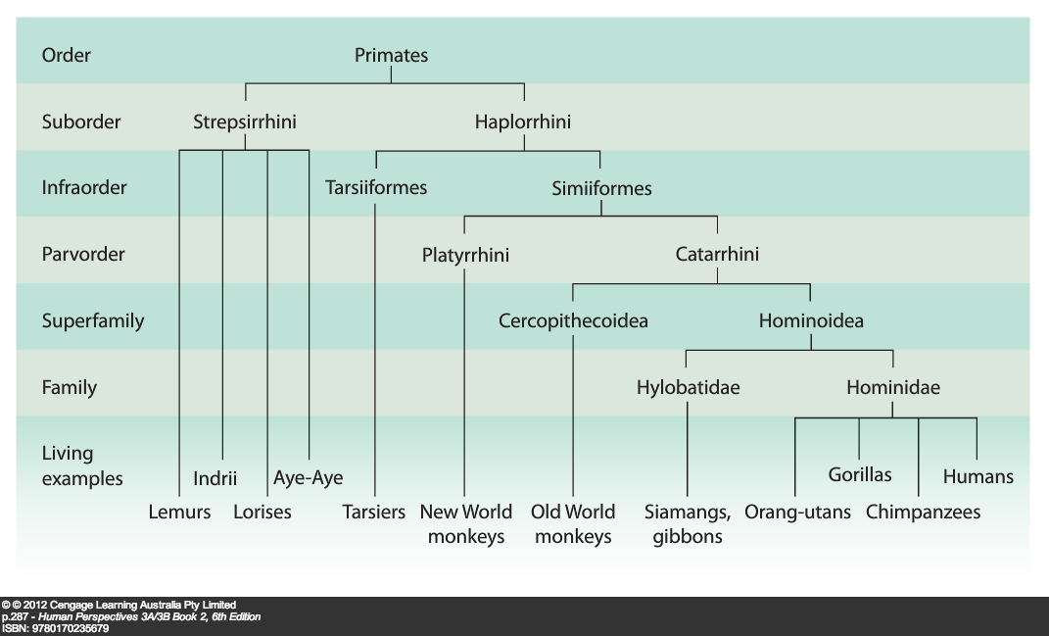

Slide 4
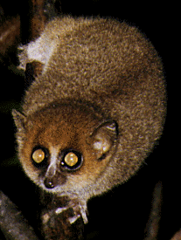
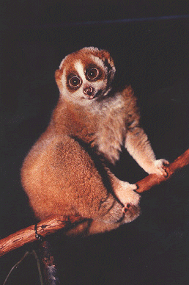
CLASSIFICATION OF THE HUMAN SPECIES
Classification of the primates
Kingdom Animalia, Phylum Chordata, Subphylum Vertebrata, Class Mammalia, Order Primates, Infraorder Simiiformes, Parvorder Catarrhini, Superfamily Hominoidea, Family Hominidae, Subfamily Homininae, Tribe Hominini, Genus Homo, Species sapiens.
The primates are classified into two main suborders: the Strepsirrhini (non-tarsier prosimians), and the Haplorrhini (tarsiers, monkeys, apes and humans.
Suborder STREPSIRRHINI (wet nose)
Prosimians – more primitive primates – aye-aye, indrii, lemurs and lorises.
Smaller brains, larger snouts than the Haplorrhini. Reproductive systems not as efficient, less manipulative ability with their hands
Lemur
Loris

Slide 5
Suborder HAPLORRHINI
Human-like primates; two main groups – Infraorder TARSIIFORMES and Infraorder SIMIIFORMES;
Tarsiiformes: Tarsiers
Simiiformes:
New World monkeys,
Old World monkeys,
Apes and humans.
Characteristics: relatively large brain, flat face with forward-facing eyes protected by bony ridges, and hands that allow considerable manual dexterity.
Two Parvorders: PLATYRRHINI – only New World Monkeys - nose flat, nostrils wide apart, dental formula 2:1:3:3 (incisors:canines:premolars:molars);

Slide 6
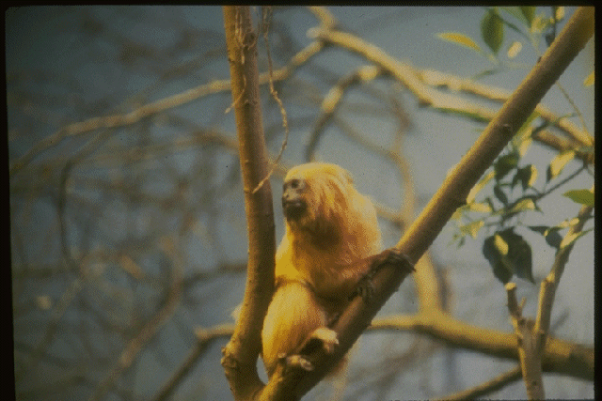
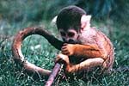
and Parvorder CATARRHINI – Old World monkeys, apes and humans - nose downward-facing, nostrils close together separated by narrow partition, dental formula 2:1:2:3
NEW WORLD MONKEYS (PARVORDER PLATYRRHINI) – found in the Americas – all arboreal, all quadrupeds, possess a prehensile tail used for hanging/swinging from branches of trees or for grasping food – marmosets, tamarins, capuchins, squirrel monkeys, howler monkeys.

Slide 7
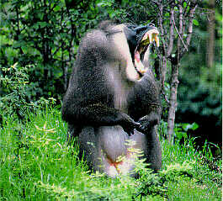
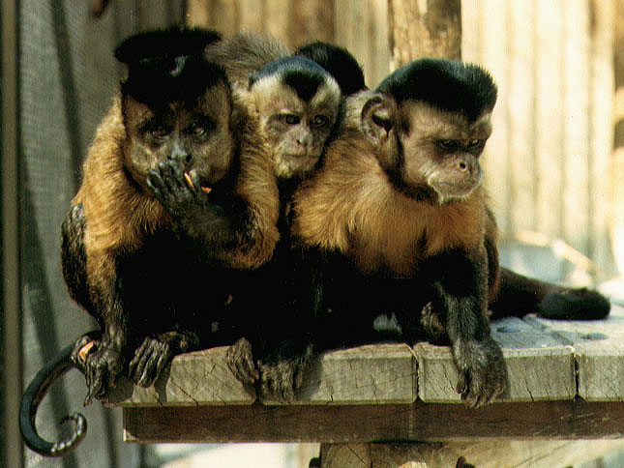
PARVORDER CATARRHINI – two groups
1. CERCOPITHECOIDEA – Old World Monkeys – widely distributed throughout Africa and Asia. Generally quadrupedal, arboreal and terrestrial, possess cheek pouches (food storage) and ischial callosities (hardened skin either side of tail) – baboons, langurs, macaques, mandrills, and colobus monkeys.

Slide 8
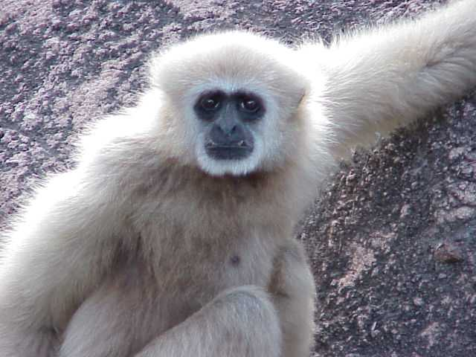
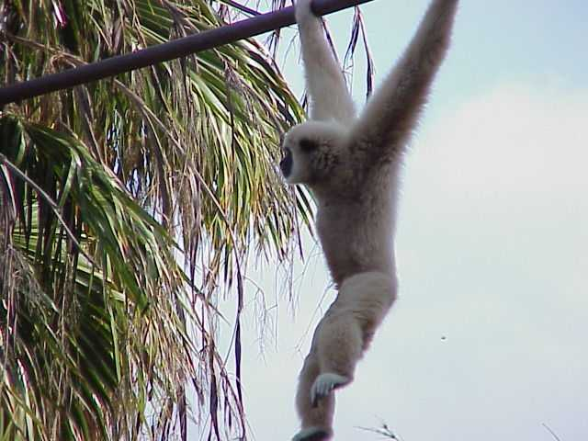
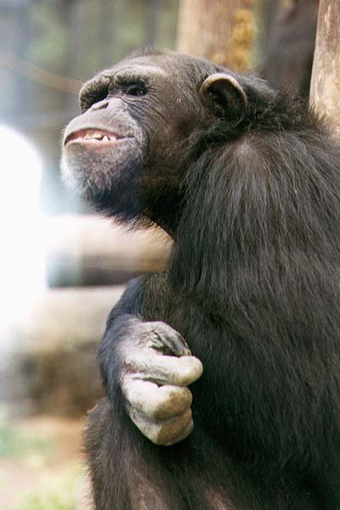
2. HOMINOIDEA – APES – gibbons, siamangs, (family Hylobatidae); orang-utans, chimpanzees, gorillas, humans (family Hominidae). Chimpanzees able to use tools, long period of dependence upon mother, problem solving ability

Slide 9
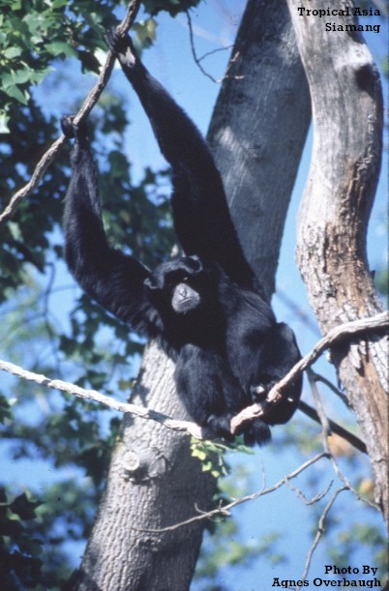
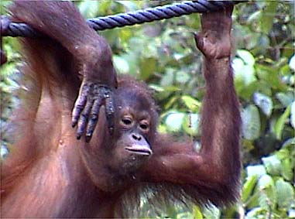
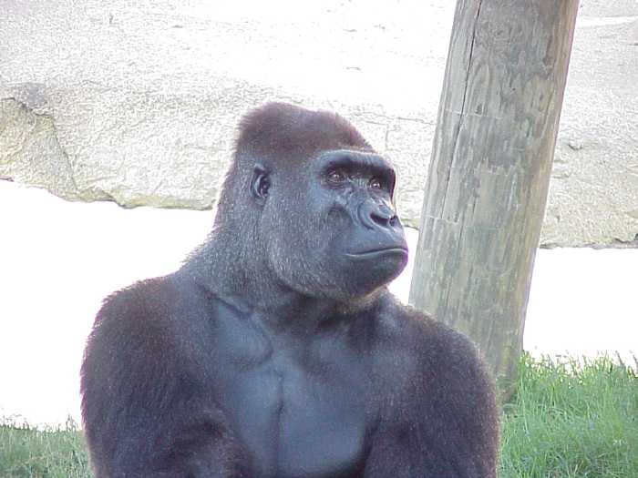

Slide 10
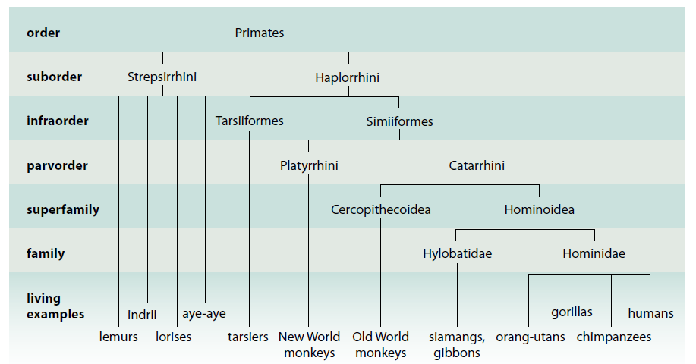
Figure 19.3 A simplified classification of the primates

Slide 11
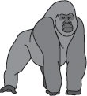

Primates and Their Characteristics
Non-specialised body
Unspecialised limbs
Pentadactyl - five fingers or toes
Nails instead of claws
Grasping fingers and toes with friction ridges for gripping
First digit opposable
Forward facing eyes for three-dimensional (stereoscopic) vision

Slide 12
Primates and Their Characteristics
Most are able to distinguish colour
Sense of smell is very poor
Four incisors in both the upper and lower jaw
Large and complex brain
Reproduction is not restricted to a breeding season
Rhythmical sexual cycle
Usually only one offspring at a time
Long period of parental care for offspring

Slide 13
Table 18.3 A summary of the characteristics of members of the order Primates
FEATURES | PRIMATE CHARACTERISTICS
BODY | Not specialised for a particular environment
LIMBS | Generally unspecialised
HANDS/ FEET | Pentadactyl—five fingers or toes Nails instead of claws Grasping fingers and toes with friction ridges for gripping First digit opposable
EYES | Forward facing for three-dimensional (stereoscopic) vision Most are able to distinguish colour
SENSE OF SMELL | Very poor
TEETH | Four incisors in both the upper and lower jaw
BRAIN | Large and complex Cerebrum increases in size as primates become more highly evolved
REPRODUCTION | Not restricted to a breeding season Rhythmical sexual cycle Usually only one offspring at a time Long period of parental care for offspring

Slide 14
Evolutionary trends within the primates
Digits
They are:
Pentadactyl – There are five digits on each of the hind limbs and forelimbs.
Prehensile – The digits are able to wrap around objects in a grasping fashion as in hanging onto a branch.
Opposable – The thumb is able to touch the tip of the other four digits. In many primates this is possible for the digits of the hind limbs as well as the forelimbs. The notable exception is humans in which the big toe is not opposable, having a far more important function in providing thrust in walking.
Nails – Instead of claws, primates have nails to allow for opposability.
Friction ridges – small ridges that provide grip; also known as fingerprints.
Precision Grip – Opposability allows for the first digit to articulate with the second digit, allowing the picking up of small objects and their manipulation through the development of fine motor skills.

Slide 15
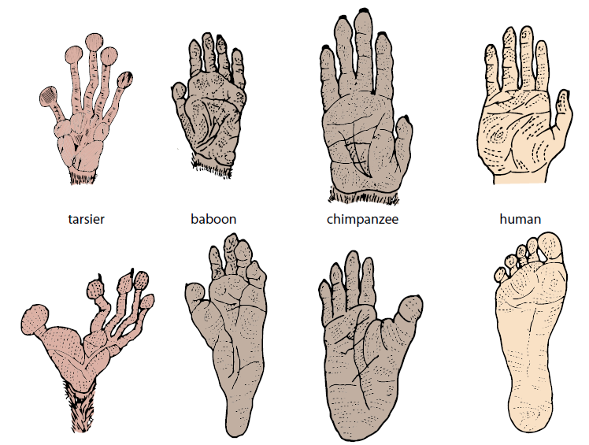
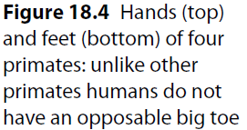
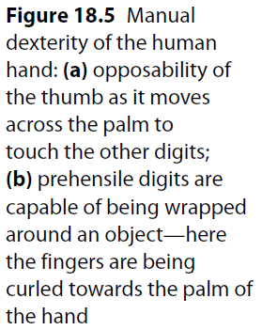
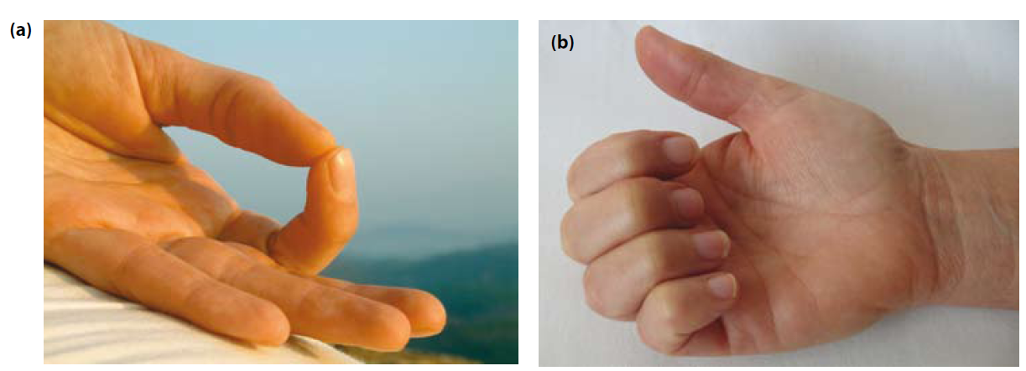

Slide 16
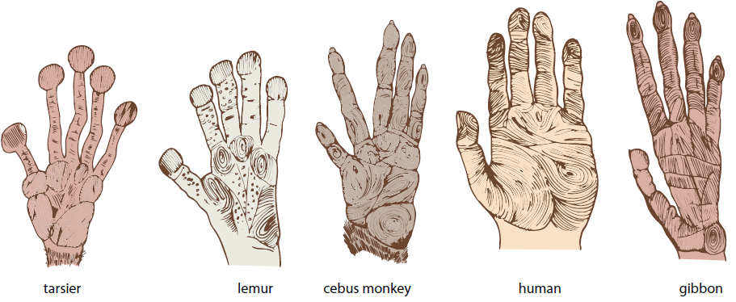

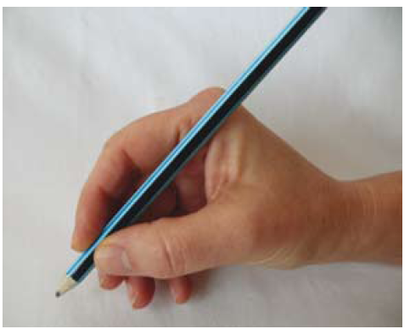


Slide 17
Dentition
Dental formula – The number of each type of tooth (incisors, canines, premolars, molars) in one quarter of the jaw.
Lemurs and lorises have 36 teeth and a dental formula of 2:1:3:3
Tarsiers have lost two incisors from their lower jaw to give a dental formula of 1:1:3:3 for the lower jaw and 2:1:3:3 for the upper jaw.
New World monkeys have the same number of incisors, canines and premolar teeth as the lemurs and lorises.
Old World monkeys, apes and humans all have 32 teeth and a dental formula of 2:1:2:3, but the arrangement differs .
Canines are usually large and sharply pointed in Old World monkeys and apes - they project beyond the level of the other teeth - modifications needed to adjacent teeth so that mouth can be closed. Most primates have a gap, or diastema, between the upper second incisor and the upper canine to accommodate the large lower canine (see Fig 18.10 (d))
Not all primate dentition is related to diet – e.g. ‘dental comb’ of lemurs and lorises . Large canine teeth of Old World monkeys and apes - more important in predator defence and social displays than for meat-eating diet.

Slide 18
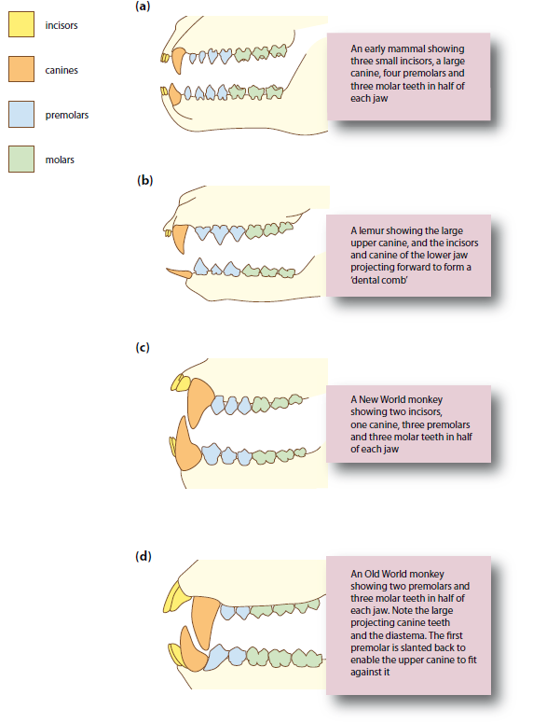


Slide 19
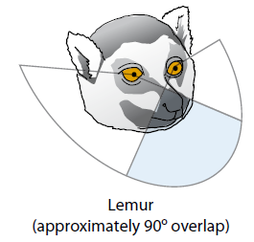
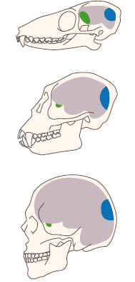
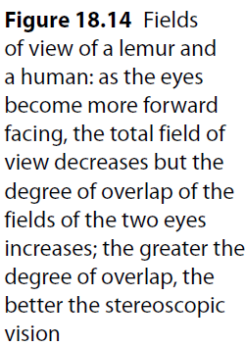
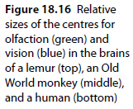
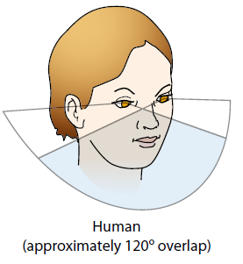
Evolutionary trends in vision
Evolutionary relocation of mammals from terrestrial (ground-dwelling) to arboreal (tree-dwelling) existence meant animals had decreasing reliance upon olfaction for gaining information about their environment.
Changes in skull shape catering for reduced olfaction and increasing vision meant
snouts became greatly reduced and
the face became flatter,
eye sockets moved from the side to the front to allow for forward-facing, stereoscopic (3-D) vision

Slide 20
Other adaptations for vision...
Highly mobile neck
Possession of rods and cones – most primates have both
Improved enervation between eye and brain
Greater protection for the eye through the development of a bony eye socket
Eye sockets have been relocated to face forward instead of being on the side.
Region of the brain devoted to vision has increased in relative size
Relative size of cerebral cortex
There is a noticeable trend from the lemurs through the monkeys to apes and humans of an expansion and reorganisation of the brain with resultant consequences for behaviour.
In primate brains, operations such as vision and olfaction are carried out by the cerebral cortex. Progressive expansion of the cerebral cortex has resulted in it becoming so large that it covers the rest of the brain. This is most noticeable in humans.
This region of the brain is concerned with higher functions — vision, memory, reasoning and manipulative ability — functions necessary to adapt to changes in environment.

Slide 21
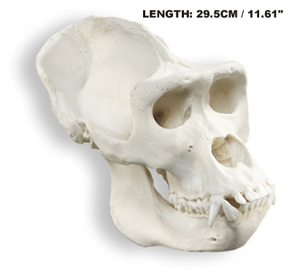
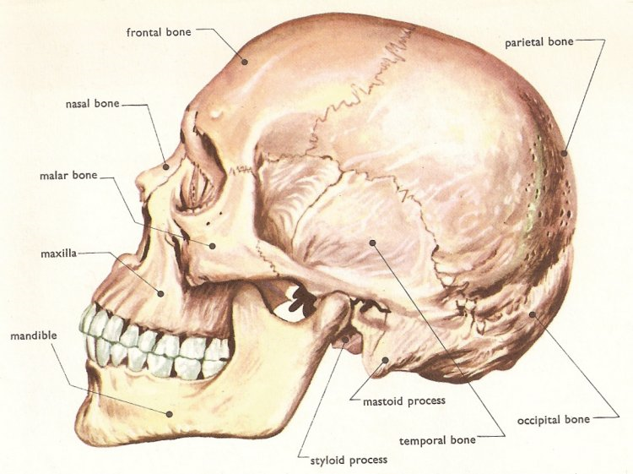
Humans have relatively large brains – range in size from 900 to 1200 cubic centimetres – average around 1350 cm³. Other hominins – average between 400 and 500 cm³. Most of the increase in size is associated with the cerebrum. SA greatly increased by convolutions. Large brain requires large skull. Brow tends to be vertical, lacks brow ridges – shortened snout – characteristic flat face. Small jaw – small teeth – smaller jaw muscles than other hominins (e.g. gorillas).
Opening in the cranium – foramen magnum – passage for the spinal cord. In humans, foramen magnum well forward, vertically beneath the top of the skull – skull easily balanced on the spine.

Slide 22
Behaviour changes possible with an increase in the size of the cerebral cortex:
Toolmaking – Humans and chimpanzees are able to visualize the tool they need and manufacture it (chimpanzees to only a limited degree) to suit their needs.
Problem-solving – Issues within the group that require clear understanding of a need for hierarchical structure
Gestation and parental care
Most primates only give birth to one offspring at a time.
There is a longer period of time devoted to maturation and growth
Compared with the other primates, human and apes have more efficient placentas that allows a closer contact between the blood supplies of the mother and the developing offspring.
Gestation remarkably long in primates compared to other mammals of comparable size – e.g. Tarsiers – single offspring after gestation period of 6 months; c.f. Rodents e.g. Rat – 6 or more offspring after gestation period of only 3 weeks.
Among the primates, gestation is longest in apes and humans, and offspring are more immature, requiring much care and protection.

Slide 23
The period of parental care increases with progression from lemurs and lorises through to the monkeys, apes and humans. For example, lemurs are weaned after 4-5 months, c.f. Apes - breast feeding continues for 3 – 4 years and protection provided for many years after this.
There is an associated delay in maturation – sexual maturity is attained much later in apes and humans than in lemurs, lorises and monkeys – means that their period of learning is also greatly extended – an important facet of a primate’s life as it enables ideas and techniques to be passed on from one generation to another.
The delay in maturation and the late arrival of sexual maturity, especially in apes
and humans, tends to reduce the number of offspring a female can have during her lifetime – makes each offspring particularly important and considerable time and effort is invested in their care and survival – increases survival chances of offspring and provides a long period during which young can learn from older members of the group.

Slide 24
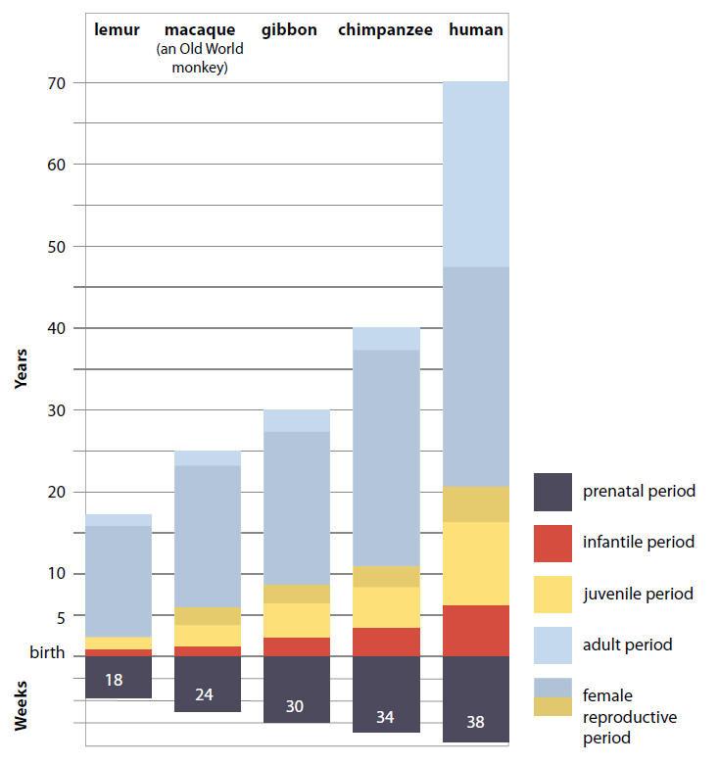
Figure 18.18 The increase in developmental and
reproductive periods, with progression from the lemurs to humans

Slide 25
Table 18.4 A summary of the evolutionary trends that occur in the order Primates
Characteristic |  | Trend
Digits | Mobility | Increasing mobility and ability to move digits independently of one another
 | Opposability | First digit opposable and increasing length results in increased effectiveness of opposability
 | Nails/claws | Primitive primates retain claws on some digits; higher primates have nails on all digits
Dentition |  | 36 teeth in lemurs and lorises; 32 in monkeys, apes and humans. Monkeys and apes—large projecting canines with diastema 4-cusped molars in monkeys; 5-cusped in apes and humans
Smell |  | Sense of smell reduced with gradual reduction in length of the snout

Slide 26
Characteristic |  | Trend
Vision | Eyes | Increasing efficiency in vision Eyes becoming gradually more forward facing to give stereoscopic vision
 | Eye socket | Eyes gradually becoming enclosed in a protective bony socket
 | Visual area of brain | Increasing proportion of the cerebrum devoted to vision
Brain | Size | Increasing size of brain relative to size of body
 | Convolutions | Gradual increase in the number of folds in the surface of the cerebrum
 | Cerebral cortex | Cerebral cortex making up an increasingly large proportion of the brain
Gestation |  | Increasing length of time between fertilisation and birth
Development | Dependence | Increasing length of time that the offspring are dependent on the parent/s
 | Sexual maturity | Increasingly later development of sexual maturity

Slide 27

THE END

